Slide 1
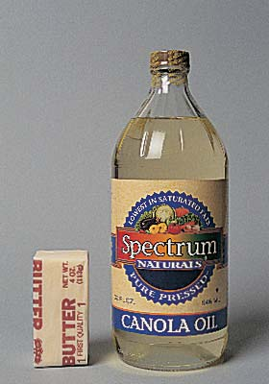
LIPIDS
INTRODUCTION TO BIOCHEMISTRY
R. MAITI
LECTURER IN PHARMACY

Slide 2
LIPIDS
Diverse hydrophobic molecules which are insoluble in water (and other polar solvents) and soluble in non-polar molecules like ether and chloroform
Made of C,H,O
No general formula.
C:O ratio is very high in C
Lipids are either compounds that yield fatty acids on hydrolysis and complex alcohols that can combine with fatty acids to form esters.

Slide 3
CLASSIFICATION OF LIPIDS
Glycerol Esters:
Triglycerides, diglycerides, and monoglycerides (acyleglycerol).
Phosphglycerides.
Sphingosine Derivatives:
Sphingomyellin.
Glycosphingolipids.
Terpenes (Isoprene Polymers):
Vitamin A.
Vitamin E.
Vitamin K.
Sterol Derivatives:
Cholesterol and Cholesterol esters.
Steroid hormones.
Bile acids
Vitamin D.

Slide 4
Fatty Acids
RCOOH is a general chemical formula for a fatty acid where R is alkyl chain.
Fatty acid chain lengths vary and commonly are classified according to the number of carbon atom present.
The defined groups of fatty acids are:-
Short chain (2 to 4 carbon atoms).
Medium chain (6to 10 carbon atoms).
Long chain (12 to 26carbon atoms).
Those of importance in human nutrition and metabolism are of the long chain class containing

Slide 5
Fatty Acids
Fatty acids are classified further according to their degree of saturation:
Saturated Fatty acids have no double bonds between carbon atoms.
Monounsaturated Fatty acids contain one double bond .
Polyunsaturated Fatty acids contain more than one double bond .
The double bonds in polyunsaturated fatty acids of both animals and plant origin are usually three carbon atoms apart.

Slide 6
Fatty Acids
The labeling of the carbon atoms in Fatty acids can be either from the carboxyl terminal (∆- numbering system), or methyl terminal (ῃ- or ɯ-numbering system). And etc…
For example Linoleic acid which contain 18 carbons and two unsaturated bonds between carbons 9 and 10 and between carbons 12 and 13, can be written as (C18:29-¹²).
By use of the (ῃ- or ɯ-numbering system) the linoleic acid would be abbreviated to (C18:2n-6) in which only the first carbon forming the unsaturated pair is written.

Slide 7
Fatty Acids
Lipids are non-polar (hydrophobic) compounds, soluble in organic solvents.
Most membrane lipids are amphipathic, having a non-polar end and a polar end.
Fatty acids consist of a hydrocarbon chain with a carboxylic acid at one end.
A 16-C fatty acid: CH₃(CH₂)₁₄-COO⁻
Non-polar polar
A 16-C fatty acid with one cis double bond between C atoms 9-10 may be represented as 16:1 cis Δ⁹.

Slide 8
Double bonds in fatty acids usually have the cis configuration.
Most naturally occurring fatty acids have an even number of carbon atoms.
Some fatty acids and their common names:
14:0 myristic acid; 16:0 palmitic acid; 18:0 stearic acid; 18:1 cisΔ⁹ oleic acid
18:2 cisΔ^{9,12} linoleic acid
18:3 cisΔ^{9,12,15} linonenic acid (an omega-3)
20:4 cisΔ^{5,8,11,14} arachidonic acid
20:5 cisΔ^{5,8,11,14,17} eicosapentaenoic acid (an omega-3)

Slide 10
There is free rotation about C-C bonds in the fatty acid hydrocarbon, except where there is a double bond.
Each cis double bond causes a kink in the chain.
Rotation about other C-C bonds would permit a more linear structure than shown, but there would be a kink.

Slide 11
Fatty Acids
Humans can synthesize most fatty acids, including saturated, monounsaturated, and some polyunsaturated fats.
However , some fatty acids cannot be synthesized like linolenic acid which is found only in plants.
Because it is not synthesized but is vital for health, growth, and development, it is termed essential fatty acid.
(required for the biosynthesis of prostaglandin).

Slide 12
Clinical importance of fatty acids
Fecal fatty acids are sometimes measured to detect malabsorptive and pancreatic disorders—the test is mostly considered obsolete.
Serum free fatty acids help distinguish between hyperinsulinemic hypoglycemia (FFA normal) and disorders of fatty acid oxidation (FFA elevated and negative ketones)

Slide 13
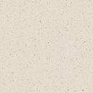
Glycerol esters (acylglycerols)
Glycerol is a three-carbon alcohol that contains a hydroxyl group on each of its carbon atom.
Each hydroxyl can be esterified with a fatty acid.
Glycerol
Triglyceride
The class of acyglycerol (glyceride) is determind by the number of fatty acyle groups present; (monoglycerides,diglycerides and triglycerides)

Slide 14
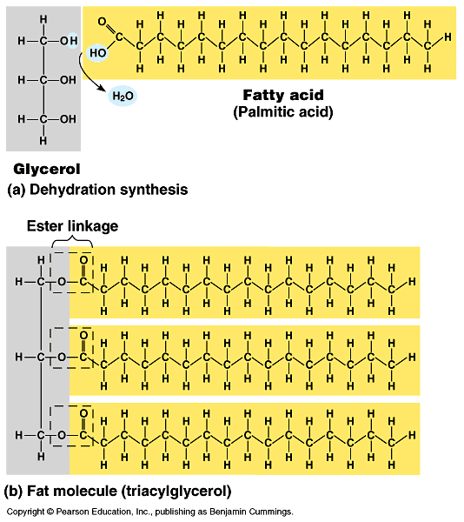
Triglyceride

Slide 15
Triglycerides
Triglycerides from plants tend to have large amount of C18:2 or linoleic residues and are liquid at room temperature (RT).
Triglycerides from animals especially ruminants, tend to have C12:0 through C18:0 fatty-acid residues (saturated fats) and are solid at RT.
Some plant triglyceride, such as coconut oil, are highly saturated and may be solid at RT.

Slide 16
Glycerophospholipids
Glycerophospholipids (phosphoglycerides), are common constituents of cellular membranes.
They have a glycerol backbone.
Hydroxyls at C1 & C2 are esterified to fatty acids.
An ester forms when a hydroxyl reacts with a carboxylic acid, with loss of H₂O.

Slide 17
PHOSPHOLIPID
O
CH₂ – O – CR₁
O
Phosphate
R₂C – O– CH
Nitrogenous base
O
(+)
CH₂ – O – P –O – CH₂ – CH₂ – N – (CH₃ )₃
O⁻
PHOSPHOLIPID
Phospholipids are complex lipids, resembling triglycerides, but containing phosphate and a nitrogenous base in place of one of the fatty acids.
They are important components of cell membranes and lipoproteins, maintaining the solubility of non-polar lipids and cholesterol.

Slide 18
Phosphatidate
In phosphatidate:
fatty acids are esterified to hydroxyls on C1 & C2
the C3 hydroxyl is esterified to P_{i}.

Slide 19
In most glycerophospholipids (phosphoglycerides), P_{i} is in turn esterified to OH of a polar head group (X): e.g., serine, choline, ethanolamine, glycerol, inositol.
The 2 fatty acids tend to be non-identical. They may differ in length and/or the presence/absence of double bonds.

Slide 20
Phosphatidylinositol, with inositol as polar head group, is one glycerophospholipid.
In addition to being a membrane lipid, phosphatidylinositol has roles in cell signaling.

Slide 21
Phosphatidylcholine, with choline as polar head group, is another glycerophospholipid.
It is a common membrane lipid.

Slide 22
Each glycerophospholipid
includes
a polar region: glycerol, carbonyl O of fatty acids, P_{i}, & the polar head group (X)
non-polar hydrocarbon tails of fatty acids (R₁, R₂).

Slide 23
Sphingolipids are derivatives of the lipid sphingosine, which has a long hydrocarbon tail, and a polar domain that includes an amino group.
Sphingosine may be reversibly phosphorylated to produce the signal molecule sphingosine-1-phosphate.
Other derivatives of sphingosine are commonly found as constituents of biological membranes.

Slide 24
The amino group of sphingosine can form an amide bond with a fatty acid carboxyl, to yield a ceramide.
In the more complex sphingolipids, a polar “head group" is esterified to the terminal hydroxyl of the sphingosine moiety of the ceramide.

Slide 25
Sphingomyelin has a phosphocholine or phosphethanolamine head group.
Sphingomyelins are common constituent of plasma membranes
Sphingomyelin, with a phosphocholine head group, is similar in size and shape to the glycerophospholipid phosphatidyl choline.

Slide 26
A cerebroside is a sphingolipid (ceramide) with a monosaccharide such as glucose or galactose as polar head group.
A ganglioside is a ceramide with a polar
head group that is a complex oligosaccharide, including the acidic sugar derivative sialic acid.
Cerebrosides and gangliosides, collectively called glycosphingolipids, are commonly found in the outer leaflet of the plasma membrane bilayer, with their sugar chains extending out from the cell surface.

Slide 27
Amphipathic lipids in association with water form complexes in which polar regions are in contact with water and hydrophobic regions away from water.
Depending on the lipid, possible molecular arrangements:
Various micelle structures. E.g., a spherical micelle is a stable configuration for amphipathic lipids with a conical shape, such as fatty acids.
A bilayer. This is the most stable configuration for amphipathic lipids with a cylindrical shape, such as phospholipids.

Slide 28
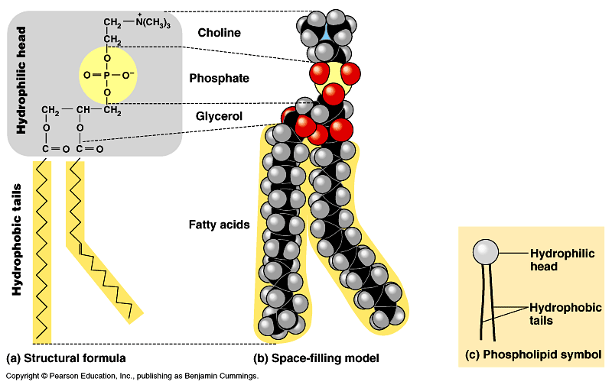

Slide 29
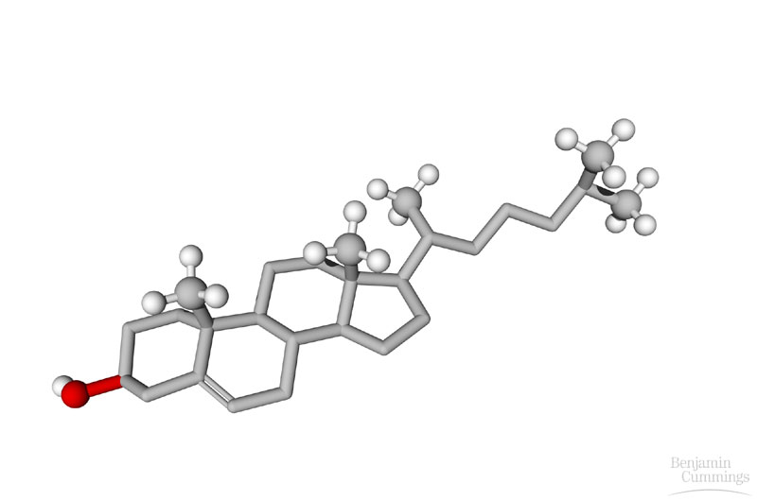
Steroids
Characterized by a backbone of four fused carbon rings.
Differ in the functional groups attached to the rings.
Examples:
cholesterol
sex hormones

Slide 30
Cholesterol, an important constituent of cell membranes, has a rigid ring system and a short branched hydrocarbon tail.
Cholesterol is largely hydrophobic.
But it has one polar group, a hydroxyl, making it amphipathic.

Slide 31
Role of Cholesterol
Keeps the lipids in membrane from aggregrating: Keeps the membrane intact as a bilayer
Precursor to Bile Acids
Act as detergents to dissolve dietary fats
Fats can be broken better by enzymes
Precursor to steroid hormones that regulate gene expression
Precursor to Vitamin D

Slide 32
Lipoproteins
Lipids must be transported to the various tissues to accomplish their metabolic functions. Because of their insolubility, they are transported in plasma in macromolecular complexes called Lipoproteins.
Chemistry:
Lipoproteins are spherical particles with non polar lipids (triglycerides and cholesterol esters) in their core and more polar lipids (phospholipids and free cholesterol) oriented near the surface.
They also contain one or more specific proteins called apolipoproteins, that are located on their surface.

Slide 33
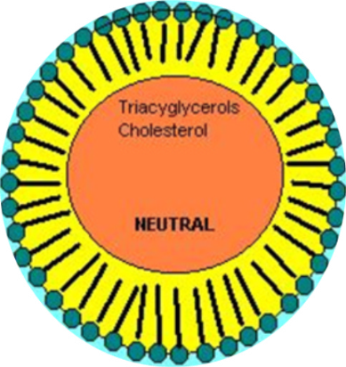
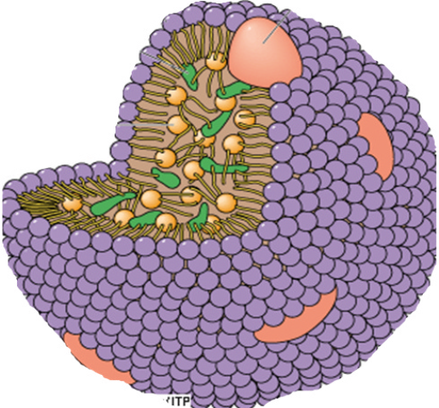
Lipoproteins
Lipoprotein: Glycerol part on outside; FA and cholesterol on inside
Spherical Lipoprotein

Slide 34
Classification of Lipoproteins
Lipoproteins are classified by their density which, in turn, reflects size. The greater the lipid/protein ratio in the complex, the larger it is and the lower its density.
There are five main classes of lipoproteins.
Triglyceride-rich particles include :
Chylomicrons, which transport exogenous lipid from the intestine to all the cells.
VLDL (very low density lipoproteins), which transport endogenous lipid from the liver to cells;.
IDL (intermediate density lipoproteins), which are usually undetectable in normal plasma. It is normally a transient intermediate lipoprotein formed during the conversion of VLDL to LDL.
It contains both cholesterol and endogenous triglycerides.

Slide 35
Classification of Lipoproteins
LDL (low density lipoproteins):
formed from VLDL, transport cholesterol to cells.
HDL (high density lipoproteins):
These are involved in the transport of cholesterol from the cells to the liver.
LDL and HDL are two smaller lipoproteins contain mostly cholesterol.

Slide 36
Ratio of LDL to HDL
LDL cholesterol of less than 100 mg/dL is the optimal level. Less than 130 mg/dL is near optimal for most people.
A high LDL level (more than 160 mg/dL or 130 mg/dL or above if you have two or more risk factors for cardiovascular disease) reflects an increased risk of heart disease
Low HDL cholesterol levels [less than 40 mg/dL] is thought to increase the risk for heart disease.

Slide 37
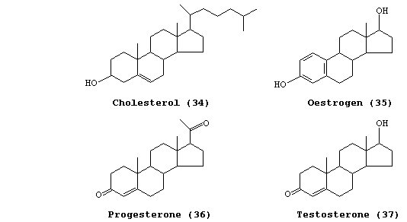
Steroid hormones

Slide 38
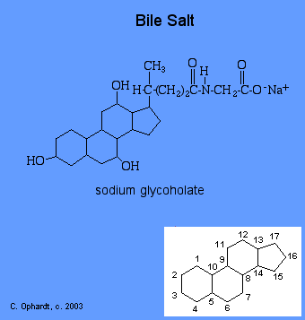

Slide 39
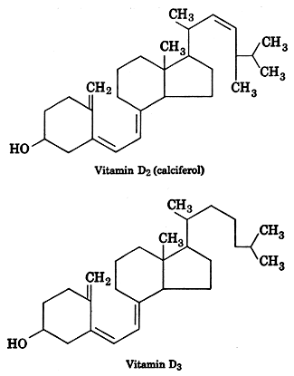

Slide 40
Eicosanoids
Prostaglandins: different types
Some stimulate contraction of smooth muscle during menstruation and labor
Others produce fever and inflammation and pain
Thromboxanes: act in the formation of blood clot
Leukotrienes: induces contraction of the muscle lining the lungs
overproduction leads to asthma

Slide 41
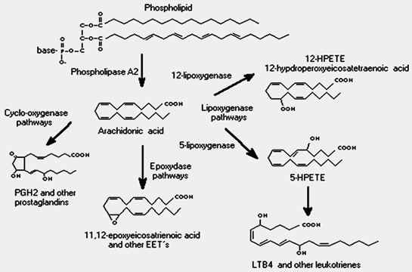
Eicosanoids/Leukotrienes

Slide 42
THE END
NAMASKAR

